Slide 1
SITREP
Assembly State
What was done to date.
Piezoelectric Disc Characterisation (data: deflections)
Who did what and why.
Assembly and test subgroup
Thomas, Jiaying: Familiarisation
Adrianne, May Chee: Piezoelectric disc characterization (increasing voltage from –10V to 10V and decreasing voltage from 10V to –10V)
Results:1.1448μm/V
Fabrication subgroup
Amanda: Familiarisation
Miles: Download of CAD files and installation of Solidworks
How is your current setup? NA
What is going to be fabricated?
Holder for tip
Holder for piezoelectric disc
Holder for sample
What is to be done:
Tracing of PCBs
Calculating transfer function for the close loop system
Issue(s) & Reflections
Key Milestones/Results
What are the problems encountered & what will be the response?
Problem(s):
Negative gradient when decreasing voltage during piezoelectric disc characterization
Response:
Do more research
What could have been done differently, with the benefit of hindsight?
Point anomalies due to switching off the voltage supply before changing of voltage.
Directly changing the voltage with the supply connected to the disc
Milestone #1 05/03
Piezo result obtained 05/03
Milestone #3 DD/MM
Mark I Setup Complete DD/MM
Milestone #5 DD/MM
Stability Measurement DD/MM
etc
Group 3 Week 1 DDMMYYYY by Name 1, Name 2, Name 3, Name 4.

Slide 2
What has been done
- Piezoelectric disc characterisation
- Downloading of CAD files for tip holder, piezoelectric disc holder and sample holder

Slide 3
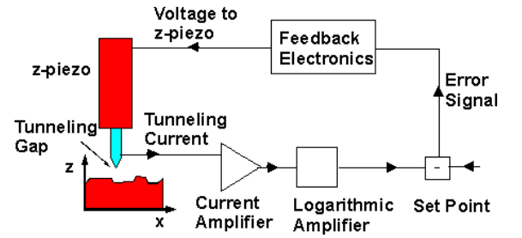
What needs to be done
Printing of the tip holder [1], piezoelectric disc holder [2] and the sample holder [3]
Tracing of the PCBs
Calculating of the transfer function for the close loop system

Slide 4
Considerations
Problem: System isolation from external disturbances to maintain constant voltage
Proposed solution: Damping system (springs?)

